Slide 1

Applying Advanced Techniques to Azure Web Apps
Azure Global Bootcamp – Waterloo, Ontario
April 21, 2018
Roy Kim @RoyKimYYZ
rkim@roykim.ca

Slide 2
Advanced Techniques
Application Gateway with Web Application Firewall
Azure SQL VNet Integration with (ASE v2)
Azure CDN
Auto Scale & Visual Studio Load Testing
By: Roy Kim roykim.ca

Slide 3
Bio
Roy Kim
14+ Years of Microsoft Technology Solutions
Azure, SharePoint, BI, Office 365
Independent IT Consultant
University of Toronto – Computer Science Degree
By: Roy Kim

Slide 4
Questions to Audience
How many are currently using Azure App Service in your organization?
What are blockers to adopt in your organization?
What kind of apps do you want to build?
By: Roy Kim roykim.ca

Slide 5
What is Azure App Service?
Azure App Service Web Apps (or just Web Apps) is a service for hosting web applications, REST APIs, and mobile back ends.
Platform as a Service Offering
You don’t manage the infrastructure
You just build with it.
Key Scenarios
Ideal for public facing web applications and web APIs
High traffic web sites with variable compute loads
Global traffic web sites
By: Roy Kim roykim.ca

Slide 6
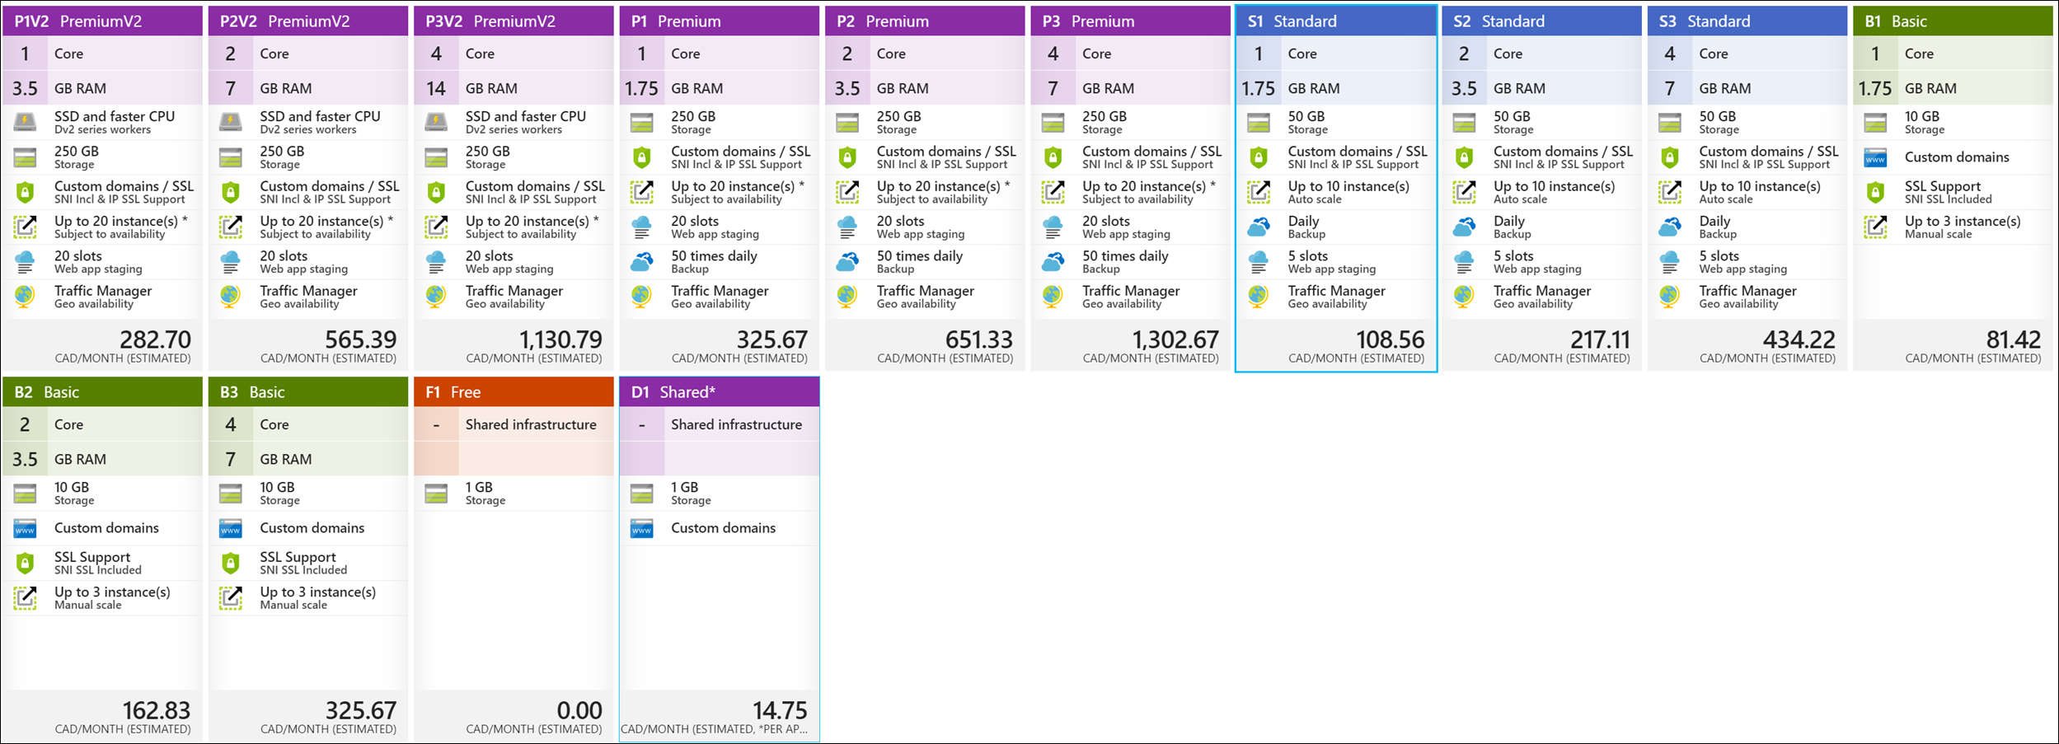
Azure App Service Pricing
By: Roy Kim roykim.ca

Slide 7
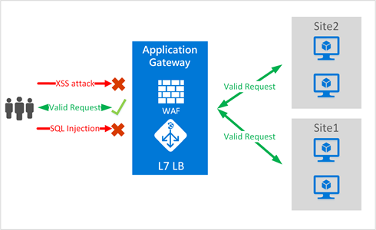
Azure Application Gateway
Azure Application Gateway is a platform-as-a-service that offers application delivery controller such layer 7 load balancing/routing capabilities and a web application firewall for many applications.
By: Roy Kim roykim.ca

Slide 8
Azure Application Gateway
Azure Application Gateway is a platform-as-a-service that offers application delivery controller such layer 7 load balancing/routing capabilities and a web application firewall for many applications.
Features Summary Web application firewall HTTP load balancing Cookie-based session affinity Secure Sockets Layer (SSL) offload End to End SSL Multi-site routing | Health monitoring SSL Policy and Ciphers Request redirect Multi-tenant back-end support Advanced diagnostics Websocket support
By: Roy Kim roykim.ca

Slide 9
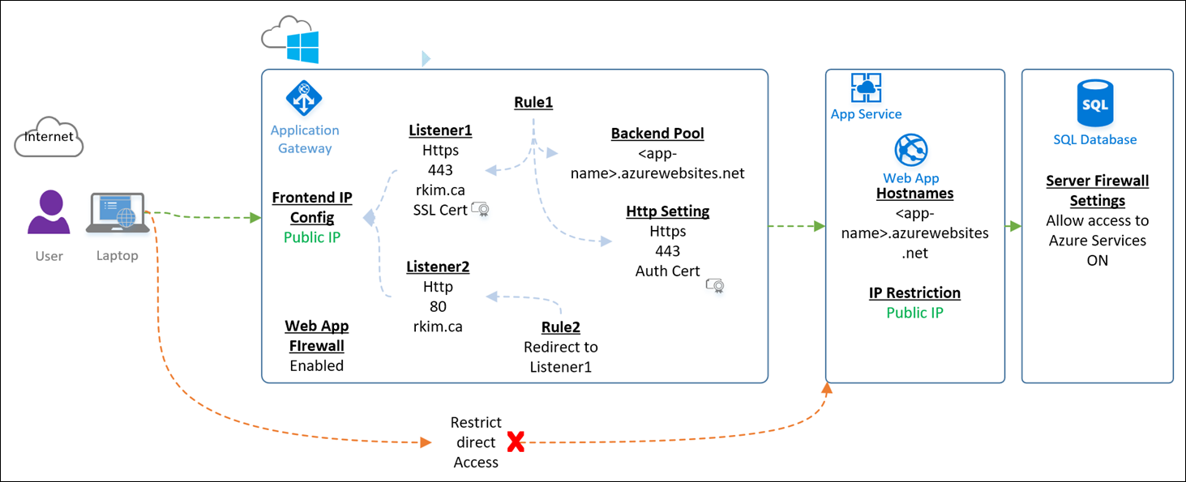
Azure Application Gateway Solution Design
By: Roy Kim roykim.ca

Slide 10
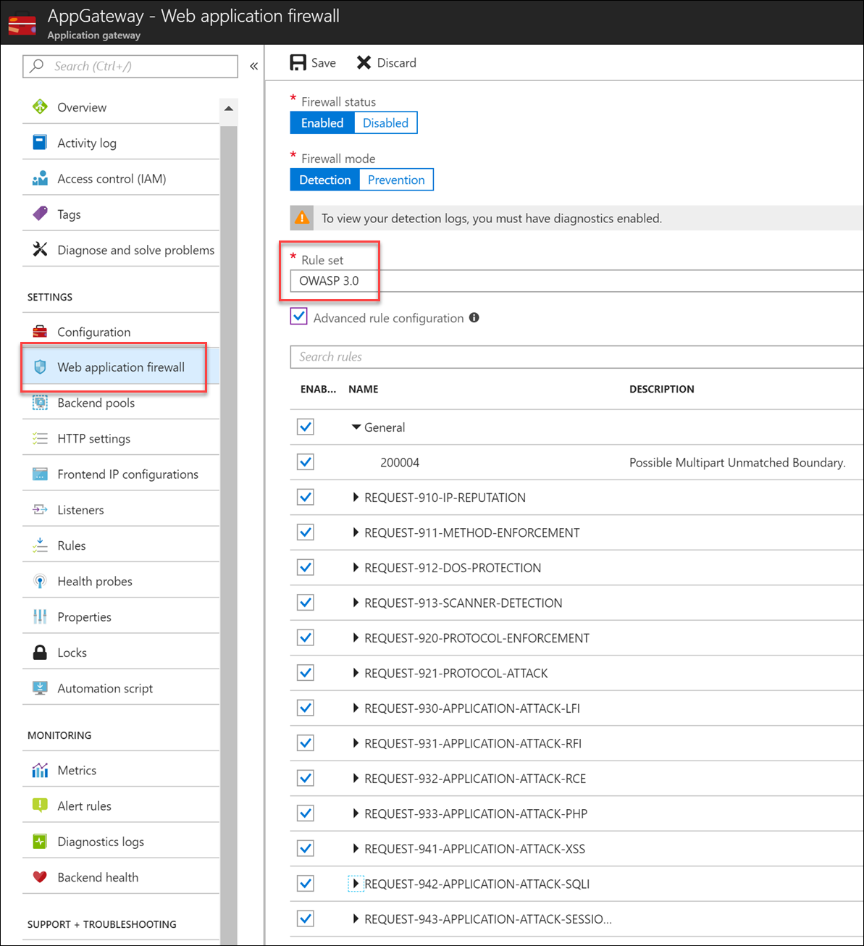
Web Application Firewall
Protect your application from web vulnerabilities and attacks without modifying backend code. Uses OWASP ModSecurity Core Rule Set
SQL injection
Cross site scripting
Common attacks such as command injection, HTTP request smuggling, HTTP response splitting, and remote file inclusion attack
HTTP protocol violations
HTTP protocol anomalies
Bots, crawlers, and scanners
Common application misconfigurations (e.g. Apache, IIS, etc.)
HTTP Denial of Service
By: Roy Kim roykim.ca

Slide 11
Azure Portal Demo - Configuration
By: Roy Kim roykim.ca

Slide 12
Azure Application Gateway
References
Configure App Service Web Apps with Application Gateway
PowerShell: https://github.com/RoyKimYYZ/Create-AzureAppGatewayAppService
By: Roy Kim roykim.ca

Slide 13
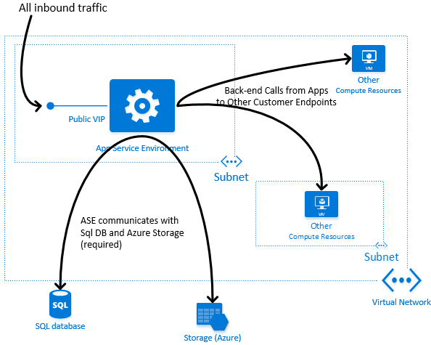
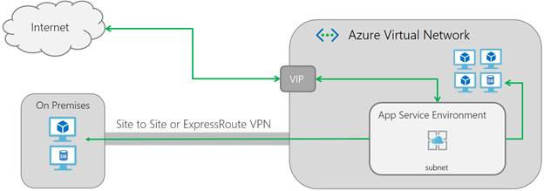
App Service Environment & Azure SQL VNET Rule
The ability to leverage Virtual Network Integration with Azure SQL for an Azure Web App in an ASE subnet, so that network traffic is contained within the Azure backbone and not via the internet.
By: Roy Kim roykim.ca

Slide 14
App Service Environment & Azure SQL VNET Rule
Specification | Purpose or Benefit
App Service Environment v2 to host Azure App Service | Secure isloated virtual network environment High scalability
Azure Web App in an Isolated App Service Plan | By design deployed into an ASE
Azure SQL | Application relational data storage for Azure Web App
Azure SQL Firewall Virtual Network Rule with VNET | Secured network access from Azure App Service to Azure SQL DB. No internet access. Network traffic is only in Azure backbone.
Advanced Techniques for Azure Web App

Slide 15
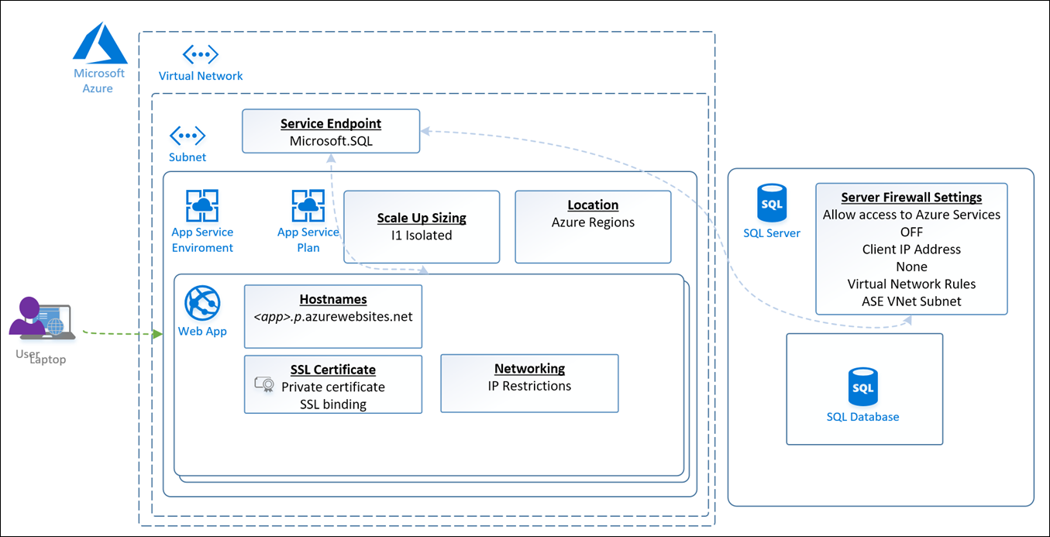
App Service Environment & Azure SQL VNET Rule
App Service Environment with App Service and Azure SQL using Virtual Network Service Endpoints
By: Roy Kim roykim.ca

Slide 16
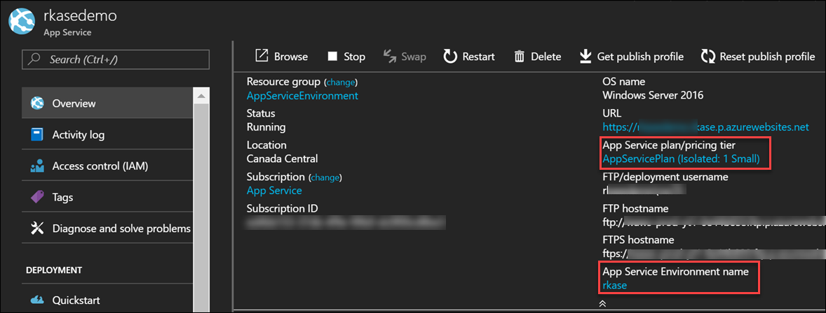
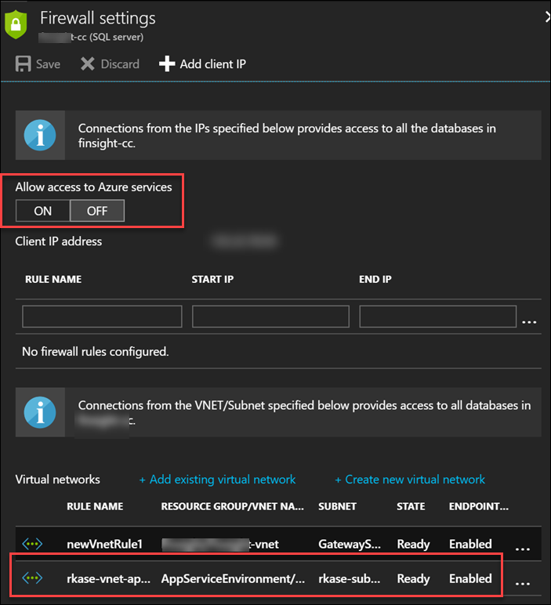
Azure Portal Demo – Key Configuration

Slide 17
App Service Environment + Azure SQL
References
App Service Environment with App Service and Azure SQL using Virtual Network Service Endpoints
Introduction to App Service environments
Network Architecture Overview of App Service Environments
Virtual Network Service Endpoints
Configure Virtual Network Service Endpoints
Use Virtual Network service endpoints and rules for Azure SQL Database
By: Roy Kim roykim.ca

Slide 18
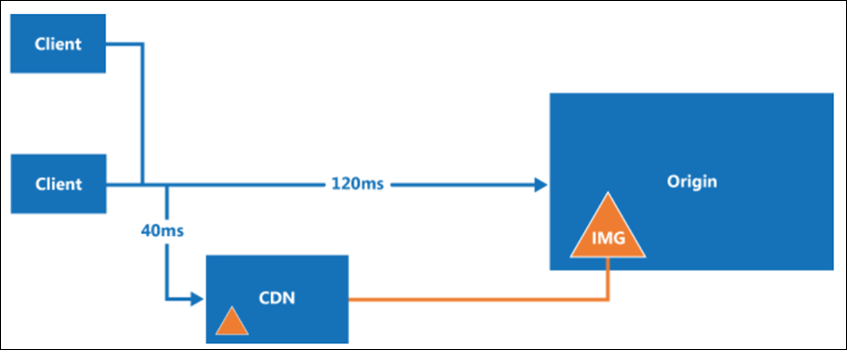
Azure CDN
Azure Content Delivery Network (CDN)
Caches static web content at strategically placed locations to provide maximum throughput for delivering content to users.
Decreases server load on your web app.
Use Azure Web App as the origin for the CDN

Slide 19
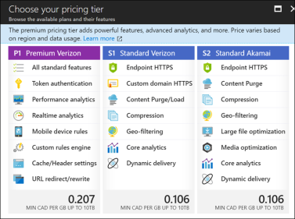
Azure CDN
Using Azure CDN offloads the compute on the Azure Web App or App Service Plan to the CDN for situations in high traffic.

Slide 20
Azure CDN
Pricing
$0.11 to $0.20 per GB
For simple web sites without much multimedia, this can make your solution much cheaper.

Slide 21
Azure CDN
Design Example
Free Tier Azure Web App
Quota 60 CPU minutes per day
Azure CDN
Custom domain and includes free SSL
Develop a caching strategy and configuration for you pages and content (js, css, images, video, etc.)

Slide 22
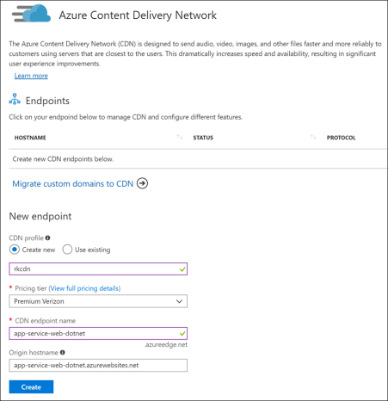
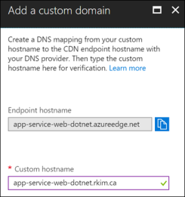
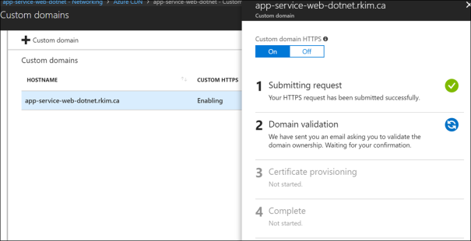
Azure Portal Demo – Key Configuration

Slide 23
Azure CDN
References
Tutorial: Add a Content Delivery Network (CDN) to an Azure App Service
Best practices for using content delivery networks (CDNs)
Super Cheap Azure Web Site using Azure CDN
Load Testing Azure CDN Caching with Azure Web App

Slide 24
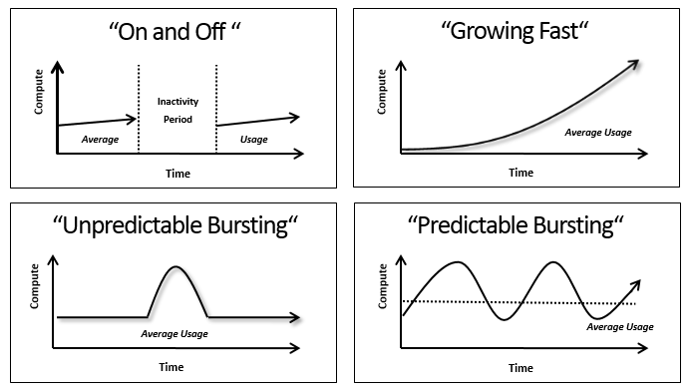
Cloud Computing Elasticity
https://labs.eleks.com/2012/12/cloud-computing-myths-fears-and-facts.html
By: Roy Kim roykim.ca

Slide 25
Load Testing & Azure Web App Auto Scale
To demonstrate the technique of load testing and seeing the effects of Azure Web App Auto Scale functionality upon load.
By: Roy Kim

Slide 26
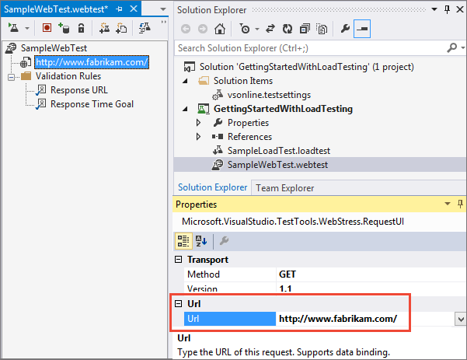
Azure Web App Auto Scale & Load Testing
Visual Studio Load Testing
Only in VS Enterprise Edition
Simulate 100s of users against browser recorded site activity
By: Roy Kim

Slide 27
Load Testing & Azure Web App Auto Scale
Azure Web App Auto Scale
Autoscaling takes advantage of the elasticity of cloud-hosted environments while easing management overhead. It reduces the need for an operator to continually monitor the performance of a system and make decisions about adding or removing resources.
Auto scale horizontally, not vertically.
By: Roy Kim

Slide 28
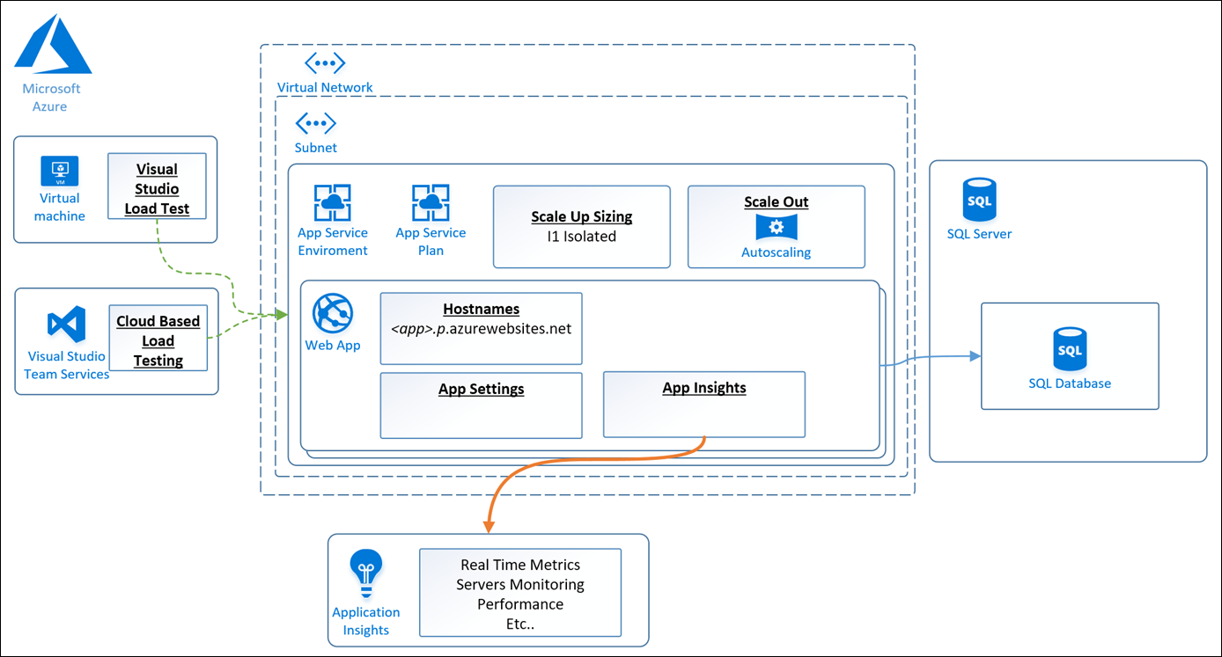
Azure Web App Demo Architecture
By: Roy Kim

Slide 29
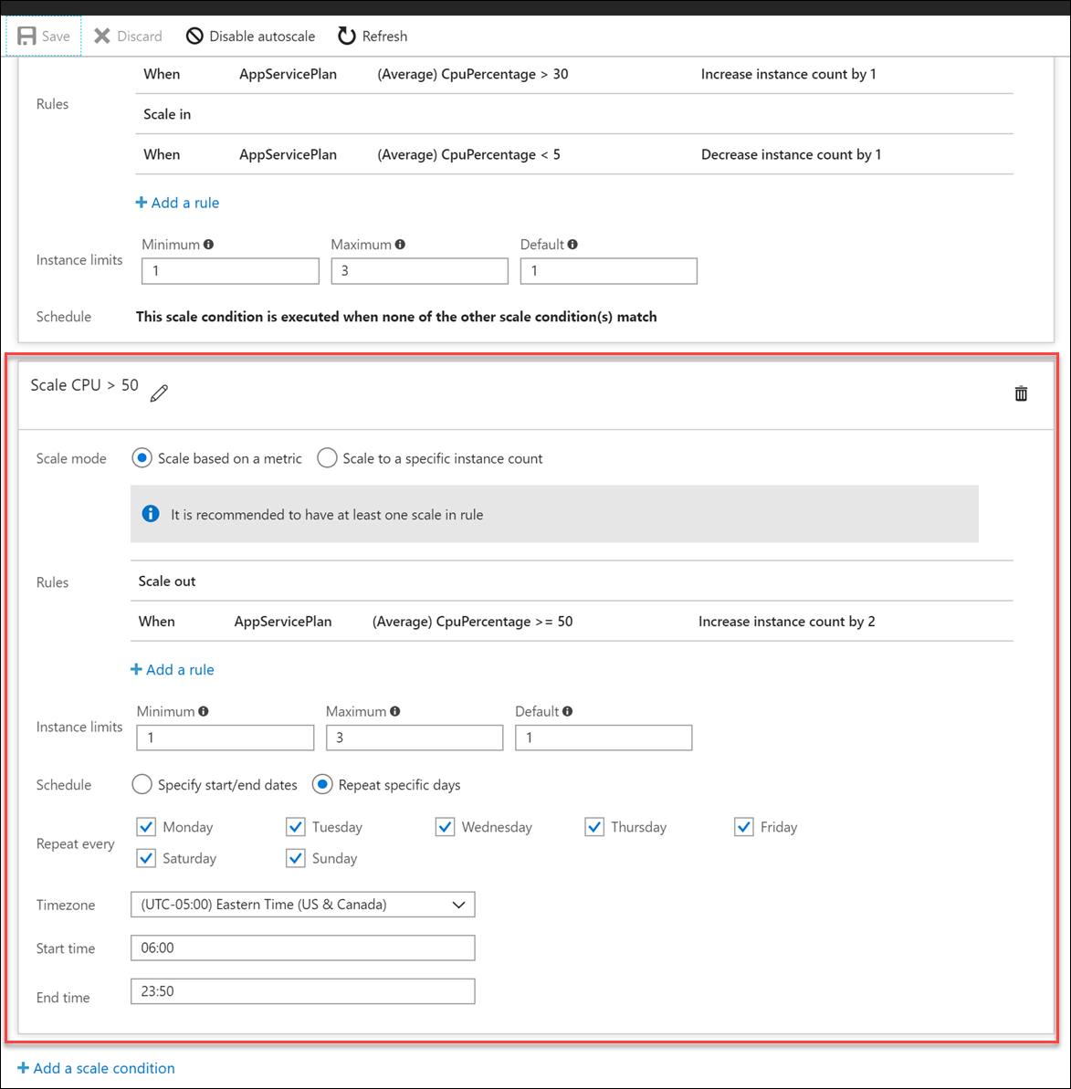
Azure Web App Auto Scale
By: Roy Kim

Slide 30
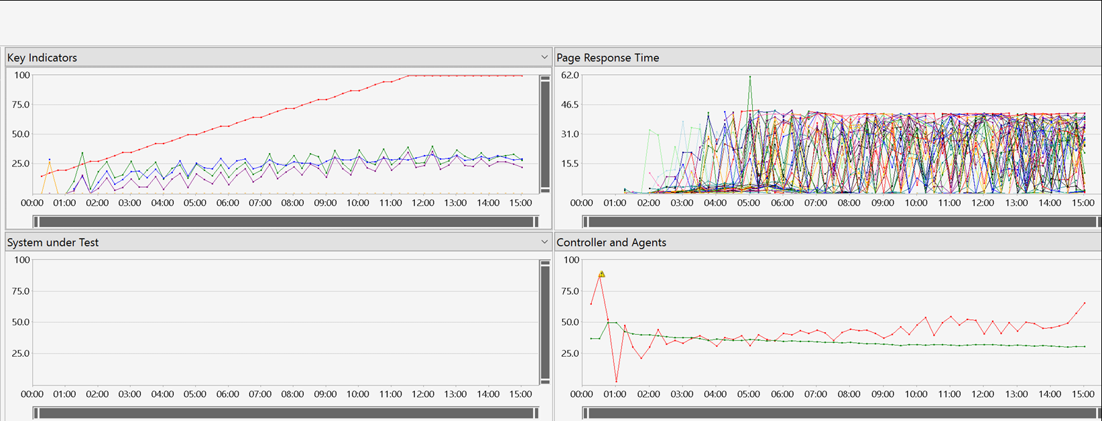
Load Test Demo
By: Roy Kim

Slide 31
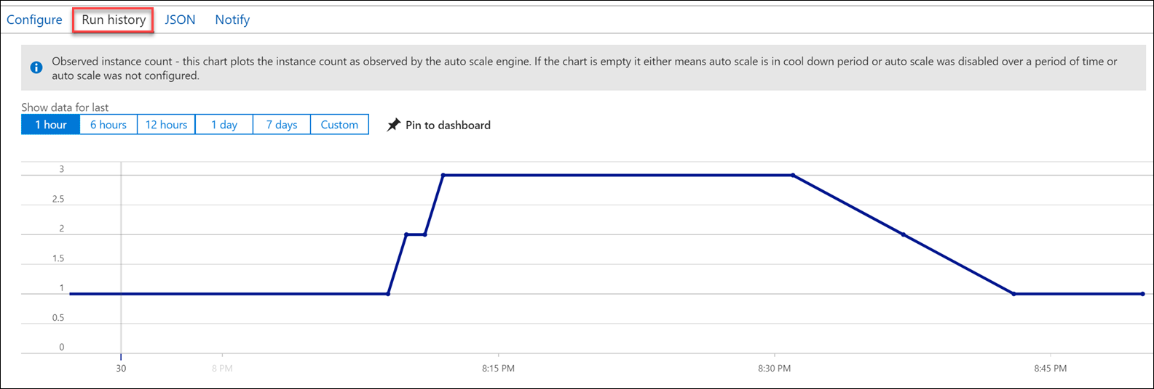
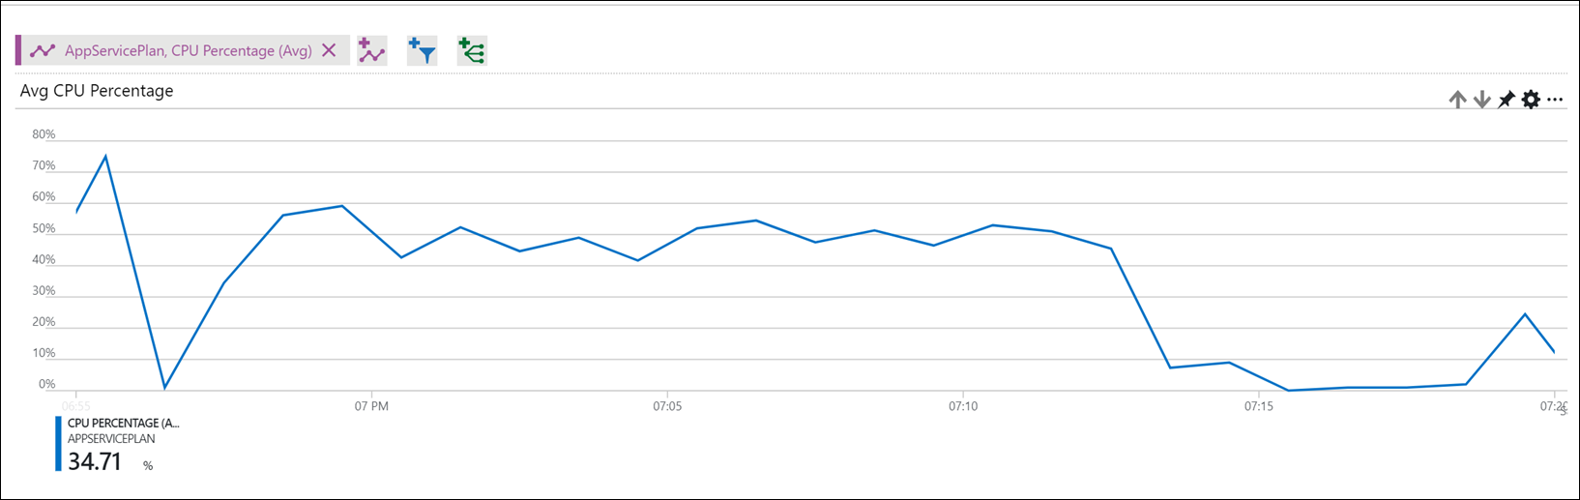
Auto Scale Demo
By: Roy Kim

Slide 32
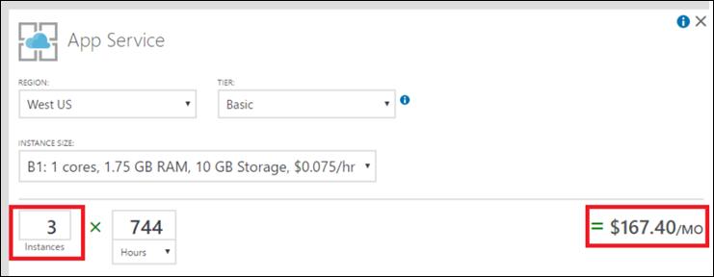
Load Testing & Azure Web App Auto Scale
Final Remarks
Auto Scale does scale immediately so don’t plan for immediate scaling on high bursts of traffic.
Costs are based on # of instances
References
Load test your app in the cloud using Visual Studio and VSTS
Azure Web App Autoscaling
By: Roy Kim

Slide 33
Call To Action
Get started with Azure Free Trials
Simple Tutorials
Build a .NET Core and SQL Database web app
Designing
Design principles for Azure applications
Best Practices for Azure App Service
Securing PaaS web and mobile applications using Azure App Service
”Learning is by doing” – Roy Kim
By: Roy Kim

Slide 34


Q & A
@RoyKimYYZ
rkim@roykim.ca
roykim.ca
By: Roy Kim

